Slide 1
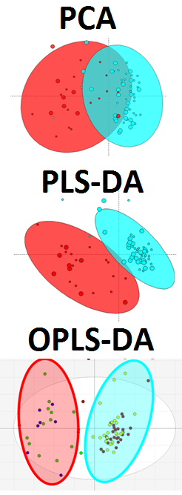
Partial Least Squares (O-/PLS/-DA) modeling of metabolomic sample processing methods
Goal:
Use PLS to identify metabolites which best discriminate (most different between) sample processing methods
(Used DATA: Pumpkin data 1.csv)
Topics:
Model Selection
Results visualization
Feature Selection
Validation
Partial Least Squares (O-/PLS/-DA)

Slide 2
Partial Least Squares Modeling Discriminant Analysis (PLS-DA)
Used DATA: Pumpkin data 1.csv
Steps
Calculate a PLS model to discriminate between extraction_treatment methods
Select optimal scaling and model latent variable (LV) number
Overview PLS scores and loadings plots
Validate model
Repeat steps 1-4 for an O-PLS model
Visualize:
Sample scores annotated by extraction and treatment
Variable loadings plot
Exercise:
How are scores different between PLS and O-PLS?
Are there any moderate or extreme outliers?
What variables contribute most to the differences between treatments?
Partial Least Squares (O-/PLS/-DA)

Slide 3
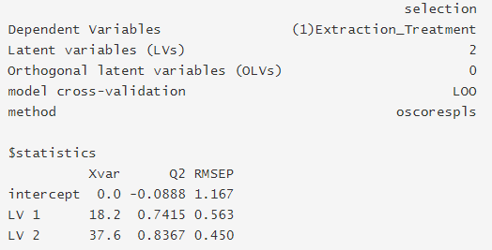
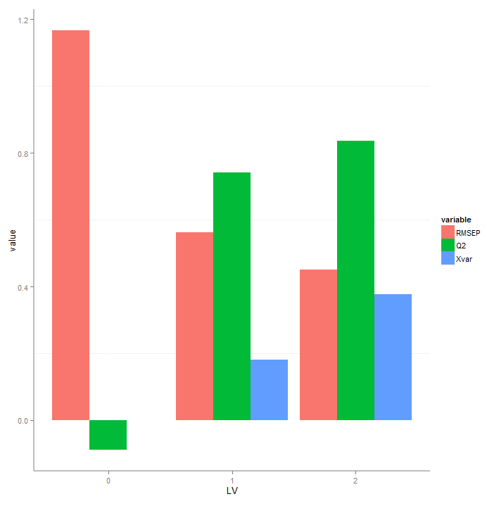
Model Performance
Statistics
RMSEP - root mean squared error of prediction (fit to left out set)
Q² - cross-validated fit to the training data
Xvar- explained variance in X (measurements)
Partial Least Squares (O-/PLS/-DA)

Slide 4
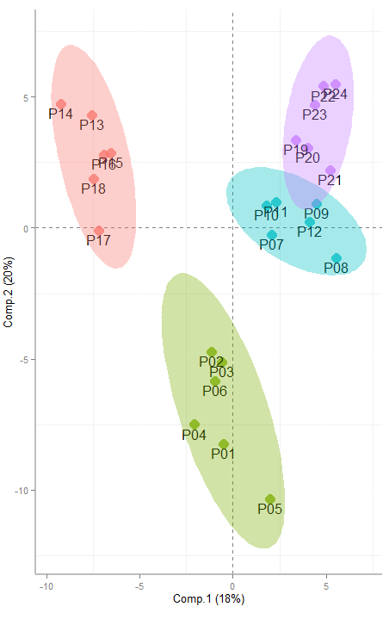
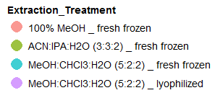
Model Scores
(extraction_treatment)
Treatment
Extraction
Partial Least Squares (O-/PLS/-DA)
Variance in extraction dominates model

Slide 5
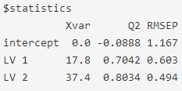
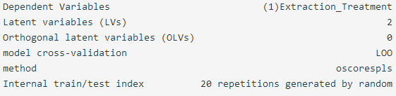
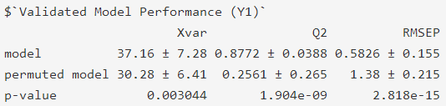
Model Validation
single model performance estimates
Model properties and validation settings
Partial Least Squares (O-/PLS/-DA)
Based on training/test splitting
Based on training/test splitting and permuted Y
Significance of difference between model performance and permuted NULL distributions

Slide 6
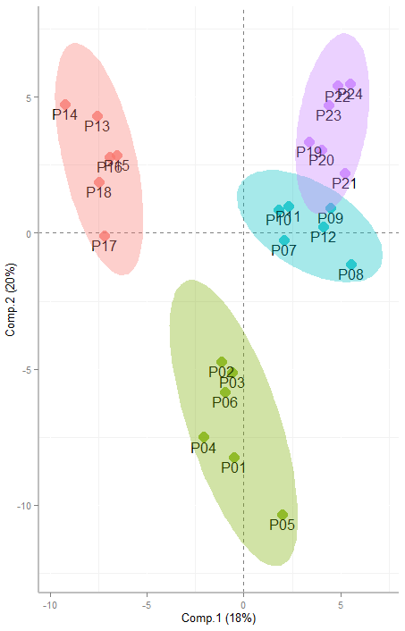
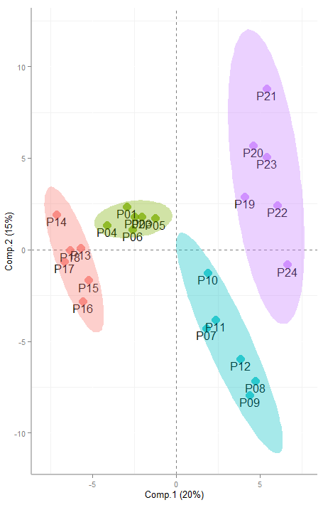
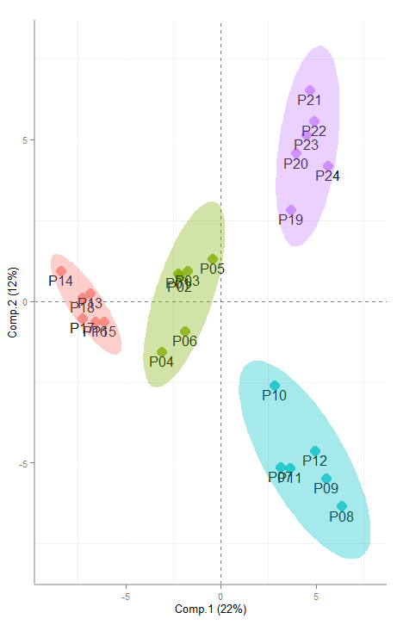
Model Scores Comparison
1-Y PLS
1-Y O-PLS
2-Y O-PLS
treatment
Partial Least Squares (O-/PLS/-DA)
extraction

Slide 7
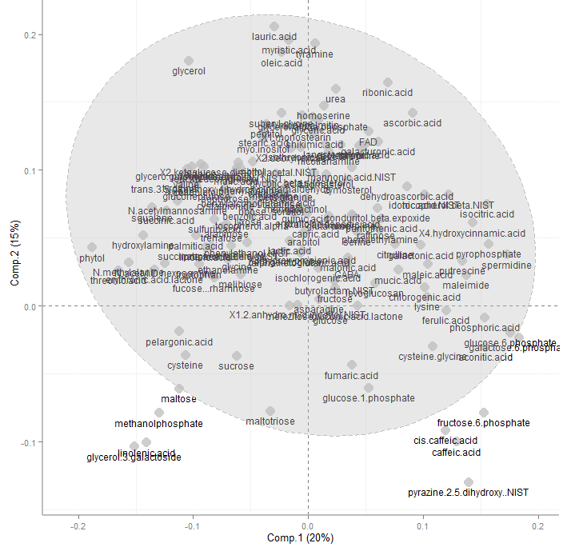

Top Discriminants
Methanol
Sugar phosphates, polyols

Slide 8
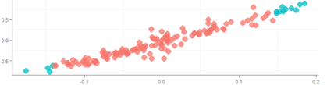
Feature Selection
Steps
Identify top 10% of discriminants for extraction_treatment based on metabolite
correlation with model scores
importance (loading, coeffcient, VIP)
Visualize:
Feature selection diagnostics
Partial Least Squares (O-/PLS/-DA)
correlation
Loading (LV1)

Slide 9
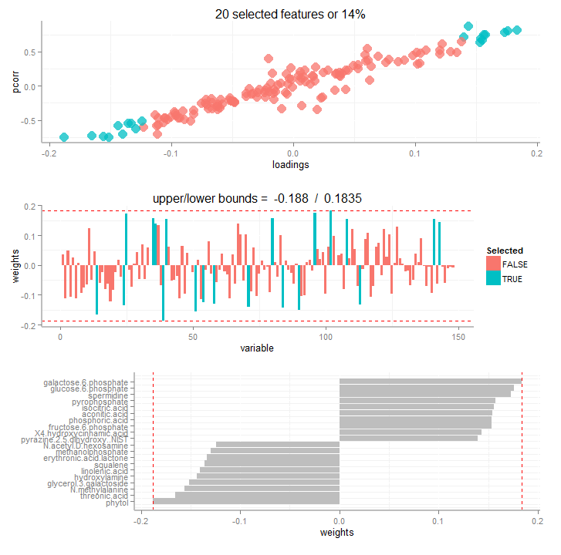
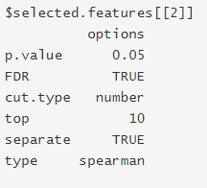
Feature Selection for Extraction
Partial Least Squares (O-/PLS/-DA)
1
2
higher in 3
3
higher in 1

Slide 10
Summary
Modeling Strategy (advanced)
Fit preliminary model
Evaluate of scores/loadings
Remove outliers
split data into test and train set (optional)
model selection (LV, OLV, etc)
internal (training set) model validation (permutation testing, training/testing)
Feature selection (optional)
Comparison of selected to excluded feature models
External model validation (test set)
Partial Least Squares (O-/PLS/-DA)

